Slide 1

Group 9
YouTube Trends

Slide 2
1. Help users (youtuber) analyze likes or dislikes of each video or video genres. For youtuber analyze the viewers preferences. For viewers to find out the hot videos based on time.
2. Find the valuable/optimal ads time for Companies(YouTube Inc. and advertisers). Analyzing the posting time of videos, we can understand the posting time patterns of various countries and different age groups.
3. Customized search and personal recommendation: users can customize search conditions / scope, the search results are customized based on profile information.
Why YouTube Trends

Slide 3
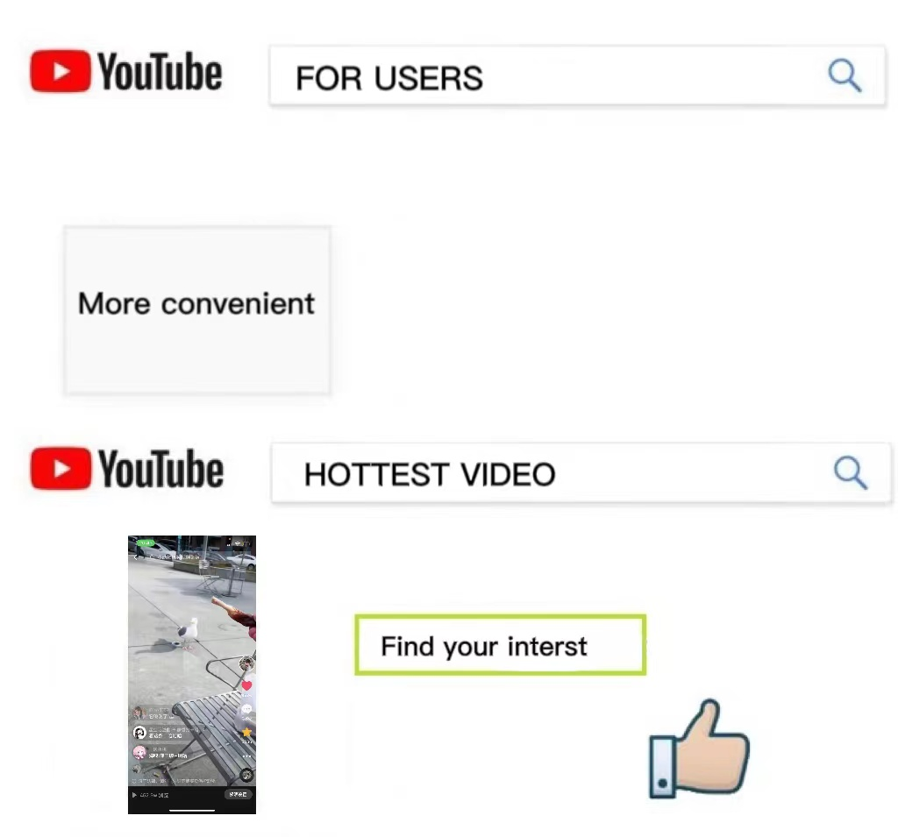
For user: Users who use our website can get the detailed data about the video directly by searching the title. Or searching the hottest videos based on the time. Users can interact with the data in our database and get the information they need, and they want.
键入说明。

Slide 4
For creator
Creators can use our website and get a clear picture of what is the trend in current time.
They can get the number of likes and dislikes of different videos.
They can learn the preferences of people in different regions by searching for the number of views of videos in different regions, to make videos that are more popular with the public.

Slide 5
What we originally planned to deliver
That is to find the most popular video according to a specific time;
Analyze the like or dislike ratio of specific video / video theme;
Find valuable / best advertiser time / theme for the company to obtain more target users;
Customize the search criteria / scope to find the most effective results for users.

Slide 6
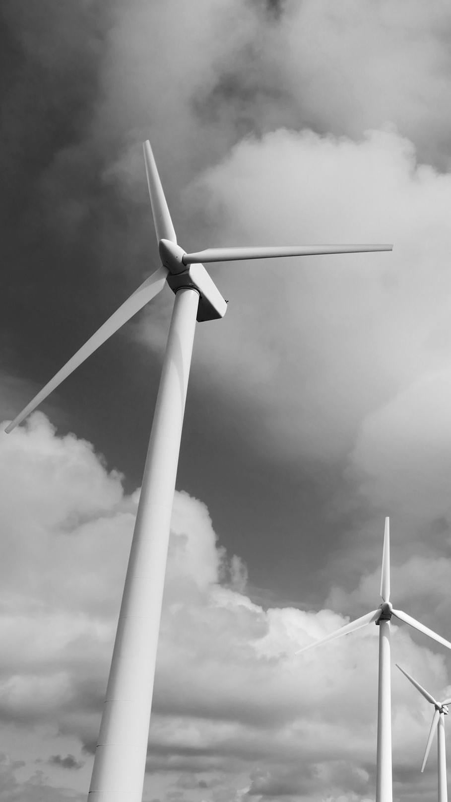
Final uml

Slide 7
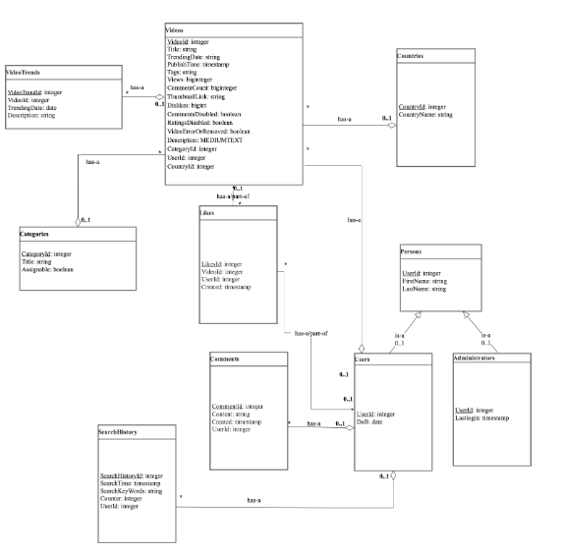

Slide 8
What were the biggest challenges?
The biggest challenge is when we merge the work that we did separately. Due to differences in everyone's environment configuration, variable settings, programming habits and many other factors, we met many bugs when merging our work.

Slide 9
What went well?
Our communication throughout the process was relatively smooth. In most cases, everyone can complete their corresponding part of the task in time. What we do especially well is that some students have sufficient experience and some students are relatively immature, but the experienced students selflessly helped newbies, so as to ensure the smooth progress of the whole project.

Slide 10
What would you do differently?
We think there are a few things we need to improve. Firstly, it would be better and more efficient if we could make uniforms at the beginning before everyone did their job. For example, we could make our variable names uniform before we broke down our tasks and delegated among members. What’s more, we could merge in advance. Therefore, we could have more time to figure out the bugs

Slide 11

Demo

Slide 12
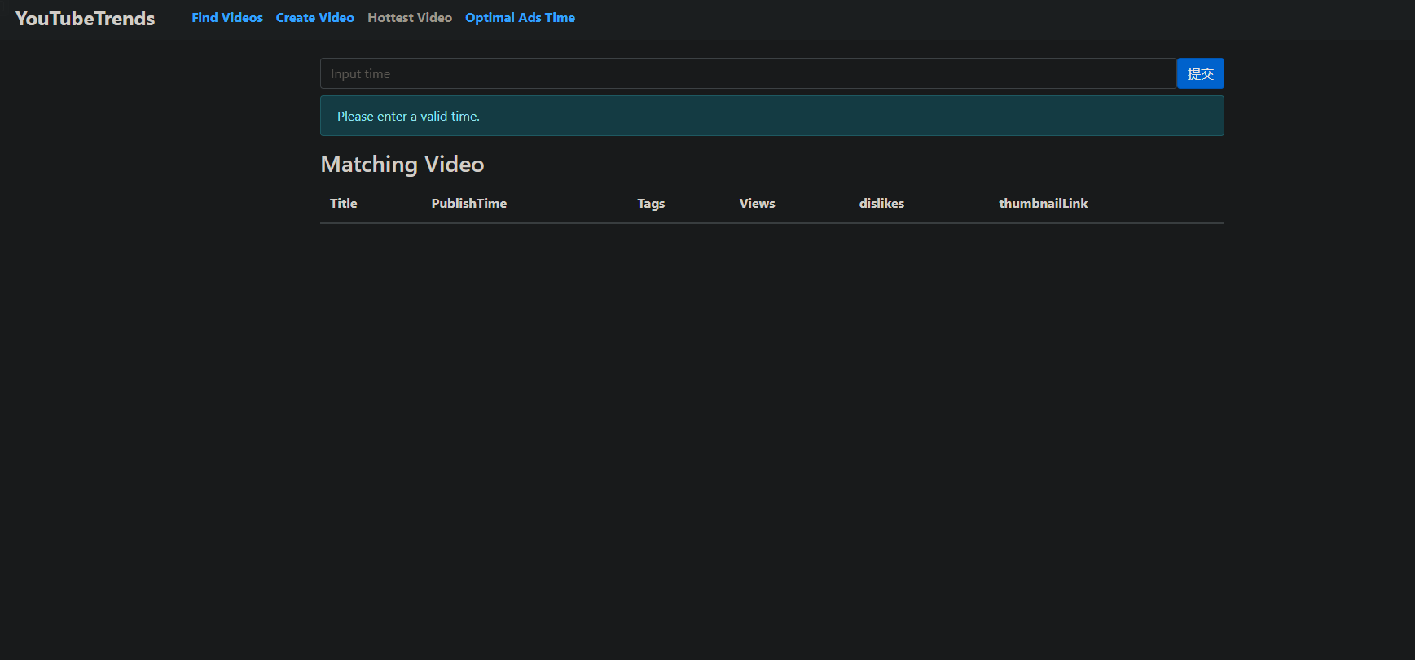
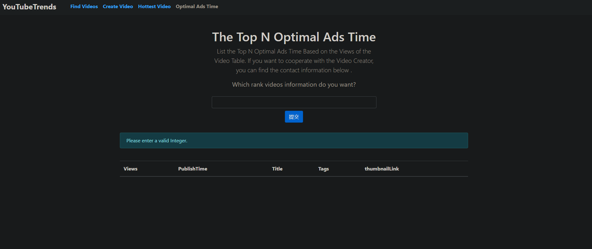

Slide 13
thanks for listening

